Slide 1



Performance Metrics

Slide 2
Regression Algorithms
Mean Squared Error
Root Mean Squared Error
Mean Absolute Error
Root Mean Squared Logarithmic Error

Slide 3
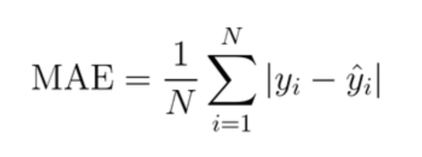
Mean Absolute Error
Is an average of the absolute errors
The mean absolute error uses the same scale as the data being measured
Used for time series modelling

Slide 4
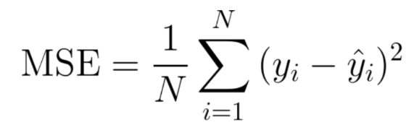
Mean Squared Error
Measures the average of the squares of the errors—that is, the average squared difference between the estimated values and the actual value
Always non-negative, and values closer to zero are better
The MSE is the second moment of the error, and thus incorporates both the variance of the estimator (how widely spread the estimates are from one data sample to another) and its bias
For an unbiased estimator, the MSE is the variance of the estimator

Slide 5
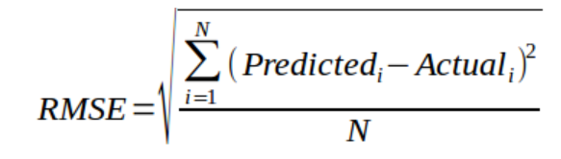
Root Mean Squared Error
Represents the square root of the second sample moment of the differences between predicted values and observed values or the quadratic mean of these differences
RMSD is always non-negative, and a value of 0 would indicate a perfect fit to the data
RMSD is the square root of the average of squared errors

Slide 6
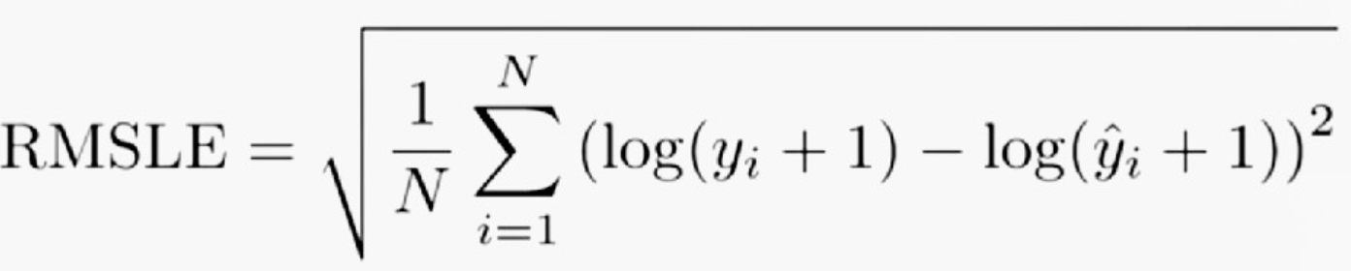
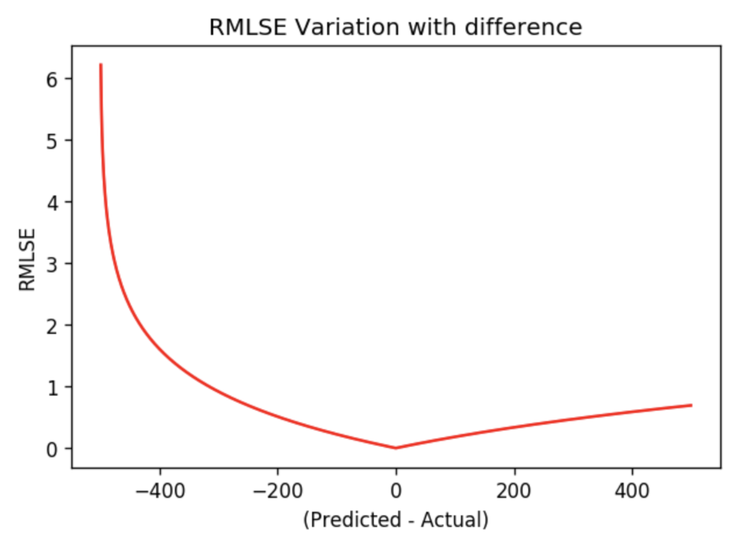
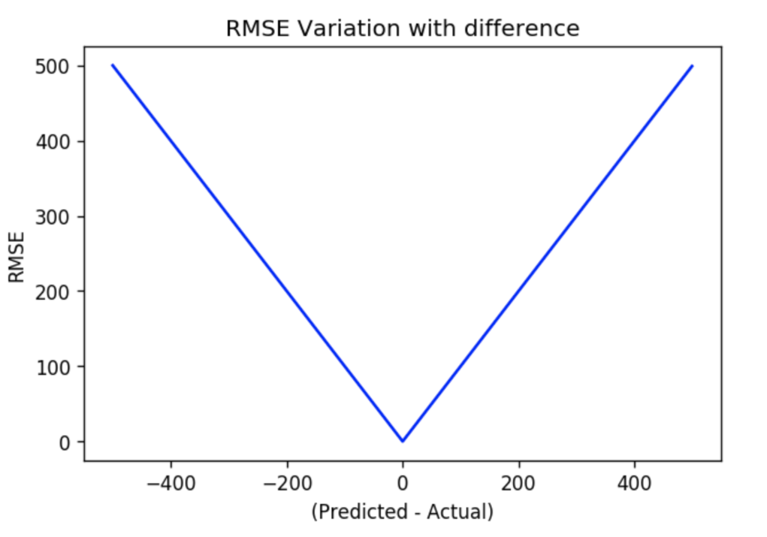
Root Mean Squared Logarithmic Error
Specialized version of RMSE by considering logarithm of actual and predicted values
Robustness to the effect of the outliers

Slide 7
Classification Algorithms
Confusion Matrix
Accuracy
Precision
Negative Predictive Value
Specificity / Selectivity / True Negative Rate
Sensitivity / Recall / True Positive Rate
F1 Score
AUC-ROC curve

Slide 8
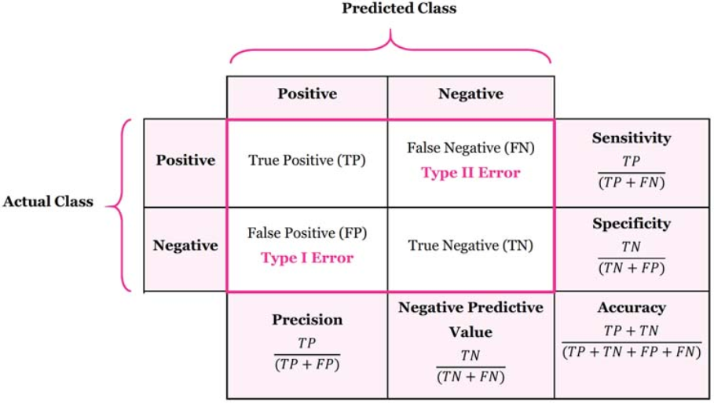
Confusion Matrix

Slide 9
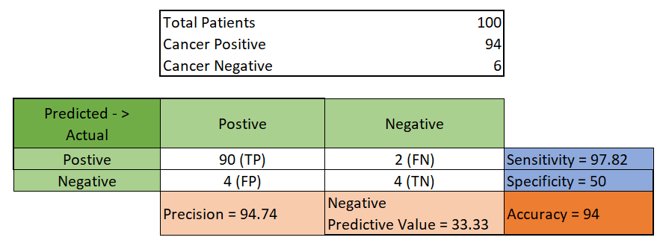
Confusion Matrix
Precision
Recall / Sensitivity / True Positive Rate
Accuracy
Specificity / True Negative Rate
Negative Predictive Value

Slide 10
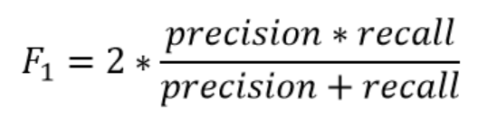
F1 Score
Harmonic mean of Precision and Reacall
Used as a single value metrics to benchmark model performance

Slide 11
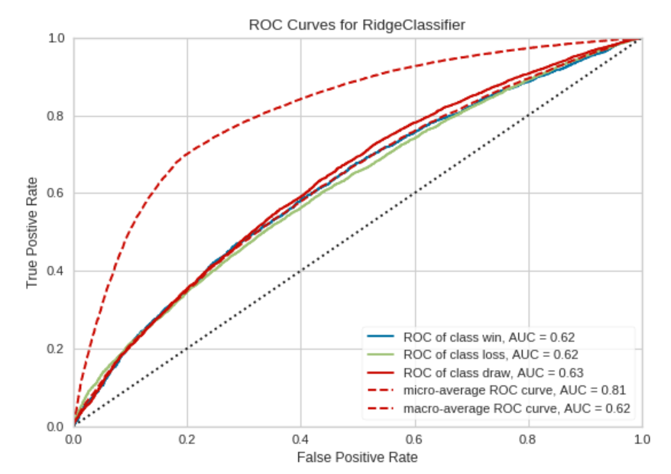
ROC-AUC Curve
Created by plotting the true positive rate (TPR) against the false positive rate (FPR) at various threshold settings
The area under the curve (AUC) is equal to the probability that a classifier will rank a randomly chosen positive instance higher than a randomly chosen negative one

